Slide 1
Crop Pro Application
Jared Conn

Slide 2
Motivation
Currently nothing like this exists on the Google Play Store
Other gardening apps provide notes and photo capabilities but not a visual representation of a crop layout
Friend who works on a farm gave me this idea

Slide 3
Proposal
To develop an Android-based tablet / smart phone application that is a visual representation of a crop and can log user input

Slide 4
App Features
Allow users to create new “plants”
Allow users to place plants in desired location on screen – also to generate a grid of plants
Allow users to select all plants and apply changes (water, fertilize, etc)
Allow users to select specific plants to add notes, photos and data
Show a current yield of the crop
Show estimated value of the yield
Include a collection of growing instructions for various plants
Allow users to change plant buttons to quickly determine what each plant is
Allow users to zoom in and out and on the crop (Birds eye view game)

Slide 5
Hardware Requirements
Android tablet or large android phone running at least android 4.0
Need to be able to make it a game?

Slide 6
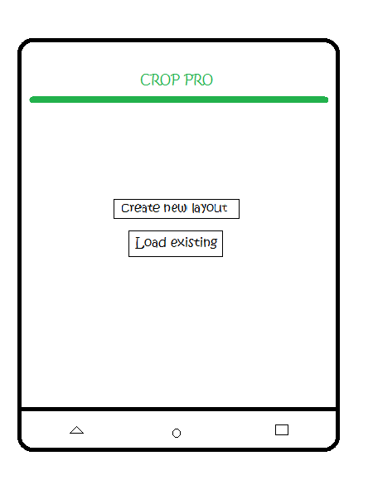
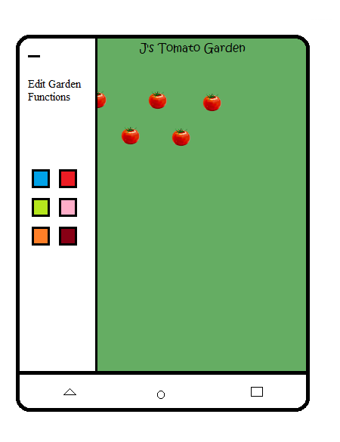
Mockup
Home screen
Load Existing

Slide 7
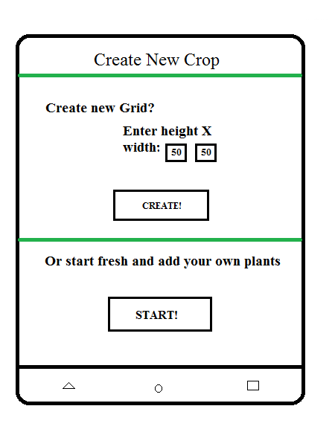
Mockup
Create New Layout

Slide 8
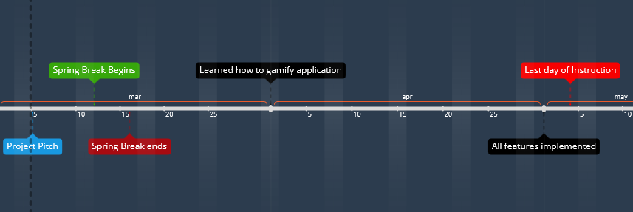
Timeline

Slide 9
Anticipated Deliverables
User Manual
Design Document
Finished Application

